Slide 1
Latest learnings on transforming your SharePoint code from server side to client side
Vesa Juvonen
Senior Program Manager
Office 365 Engineering, Microsoft

Slide 2




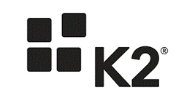

SharePoint Saturday Helsinki
Thank you to our sponsors!

Slide 3

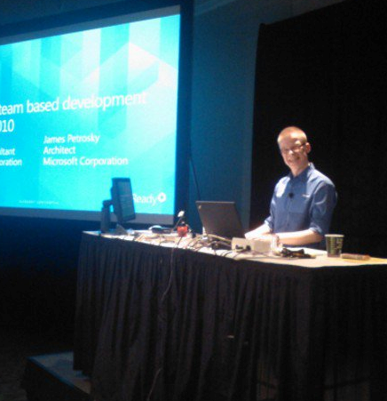



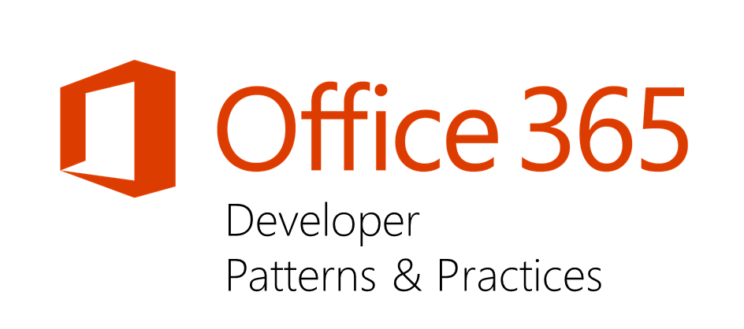
Vesa Juvonen
Pre-Microsoft
Entrepreneur, ICL, Fujitsu, Basware
Microsoft (2006-)
Senior Program Manager, Office 365 CXP CAT
Principal Consultant for 8 years before moving to PG
Office 365 Dev Patterns and Practices program lead
JDP program technical lead
MCM/MCSM Instructor & Content Owner
Instruction cross 18 rotations from start to finish of the program
Contact
Email – vesa.juvonen@microsoft.com
Blog – http://blogs.msdn.com/vesku
Twitter - @vesajuvonen
Passion for the cloud
It’s Finglish…
Doing the heavy lifting…

Slide 4

Agenda
Introduction what we do in Microsoft
Learnings from our work
Development recommendations

Slide 5

"The most strategic developer surface area for us is Office 365“ - Satya Nadella
Notes:
Why?
The key to enterprise productivity going forward
Microsoft’s strategic advantage in the Enterprise
Partners and Developers are key to its success

Slide 6
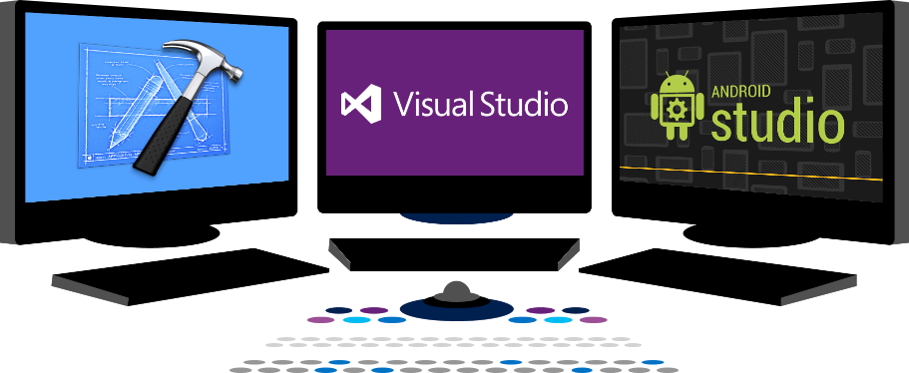














Vision
EXTEND OFFICE EVERYWHERE
CONNECT TO OFFICE 365 SERVICES
BUILD USING AN OPEN PLATFORM
Delve
z
Users and groups
Files
Mail
Calendar
My Apps
Video Portal
Contacts
Office Graph
Presentations
Documents
Spreadsheets
Lync
OneNote
Yammer

Slide 7
Transforming your code
From farm solutions and full trust code…
To app model…
Notes:
Vesa

Slide 8
“What does this mean in practice?”
Rewrite your code to app model. There’s actually no migration or transformation as such, but you can reuse concepts and patterns
Notes:
Vesa

Slide 9
“But I do want to do customizations using full trust code way!”
Feel free to do that in future as well. It comes down on the business and functional requirements, together with deployment roadmap.
Notes:
Steve
Time: 15:00

Slide 10
“Will Farm Solutions be supported with SharePoint Server 2016”
Yes.
We will make though investments mainly on the app model side also for on-premises to better align the development story: Write once and use it cross cloud and on-premises
Notes:
Vesa

Slide 11
“I saw a blog post in Internet saying that app model is dead”
No it’s not
It’s more live than ever. We are committed on this model and majority of our development investments are placed on the app model topics for cloud AND on-premises
Notes:
Vesa

Slide 12

Introduction on the model in Microsoft
How we work in this areas?
How we introduce recommendations?
How we introduce changes?

Slide 13
“Microsoft is coming up with recommendations without knowledge on what field needs”
Actually… No
We have multiple virtual teams who are working closely full time with customers on app model topics related on the cloud and also on-premises. Our recommendations are coming from real life customer work.
Notes:
Vesa

Slide 14
”MS clearly does not understand where field is and how things are done!”
What if we actually do, but want to gradually direct you on the right direction to align with the product and service roadmap?
Notes:
Steve
Time: 15:00

Slide 15

aka.ms/OfficeDevPnP
Transform your code
Providing App Model Patterns for common scenarios Open source and based on community contributions Constantly evolving set of material for reuse
100+ Visual Studio projects
Common scenarios Branding Site provisioning Remote event receivers
UX component Taxonomy driven navigation And much more…
Patterns and Practices Yammer Group - http://aka.ms/officedevpnpYammer

Slide 16
O365 Dev Patterns and Practices model
Engineering input for API changes
Core component
Community
Training
Presentations
PnP
JDP program
Guidance / MSDN
Seminar materials
Videos
Other assets

Slide 17
Application Modernization: JDP Program
WHERE ARE WE AND WHERE ARE WE HEADING?
Customer Preparedness
Solution Assessment
Architecture Session
STEP 1
Empower & Plan
Prepare app hosting configuration. Leverage available resources to ramp up dev resources
Analyze solution inventory / requirements and provide guidance on solution modernization
Provide architecture design guidance for selected scenarios
Deliverable:
Successful smoke test app to validate configuration
Deliverable:
Assessment report
Deliverable:
Architecture Design Report
Development SOW (optional)
ACTUAL CONVERSION
Development & Testing
Deployment
STEP 2
Develop & Deploy
Provide funding to off-set costs associated with development and testing
Retract FTC
Deploy App solutions
Deliverable:
Tested solution artifacts
Deployment Guide
Deliverable:
Replace FTC by APP
Project signoff
Notes:
Step 1: FY15 only. It is a prerequisite for Step 2

Slide 18
Patterns and Practices training package
http://aka.ms/OfficeDevPnPTraining
Training based on the PnP material available for anyone to use
Presentations, demos and hands on labs
Recorded videos coming also soon
Introduction to app model
Managing site settings using app model
Branding with app model
Building UX components with app model
Using remote event receivers and remote timer jobs
Site collection and site provisioning
User personalization and OneDrive 4B
ECM capabilities with app model
Using search with app model
Transforming customizations to app model
Download and use as you wish…

Slide 19

Learnings
It’s not about technology
App model is extremely powerful
Provider hosted apps is the future

Slide 20
Concentrate on functional requirements, not the technology
There are numerous ways to achieve a similar end result, don’t get stuck on what you had…
Notes:
Vesa
Time:23:00

Slide 21
“Will you ever support farm solutions in Office 365?”
No.
Farm solutions are deployed cross SharePoint farm and they’d impact multiple customers…
Notes:
Vesa:
Time: 42:00

Slide 22
“Will you introduce new model for app model replacement in near future?”
No.
App model solutions with remote APIs and control are here to stay
Notes:
Steve
Time: 44
NOTE: You may have seen our investments in Common Consent and O365 APIs, this should help you understand that we are investing in evolving this model going forward !!!

Slide 23
“I can’t do XYZ with app model?”
There are numerous things which might not be available as such with app model, but functional requirements can be often achieved using alternative methods
Notes:
Vesa
Time: 45

Slide 24
You can actually do much more with provider hosted model than with typical farm solutions…
Especially Azure based solutions have pretty much infinite opportunities. Approaches are slightly different, but the engine is super powerful
Notes:
Vesa
Time: 45

Slide 25
Site provisioning and site configuration automation is the key!
Apply needed settings and configurations to site collections and sites as part of the site provisioning. Proper site provisioning framework is where it all starts.
Notes:
Vesa
Time:23:00

Slide 26
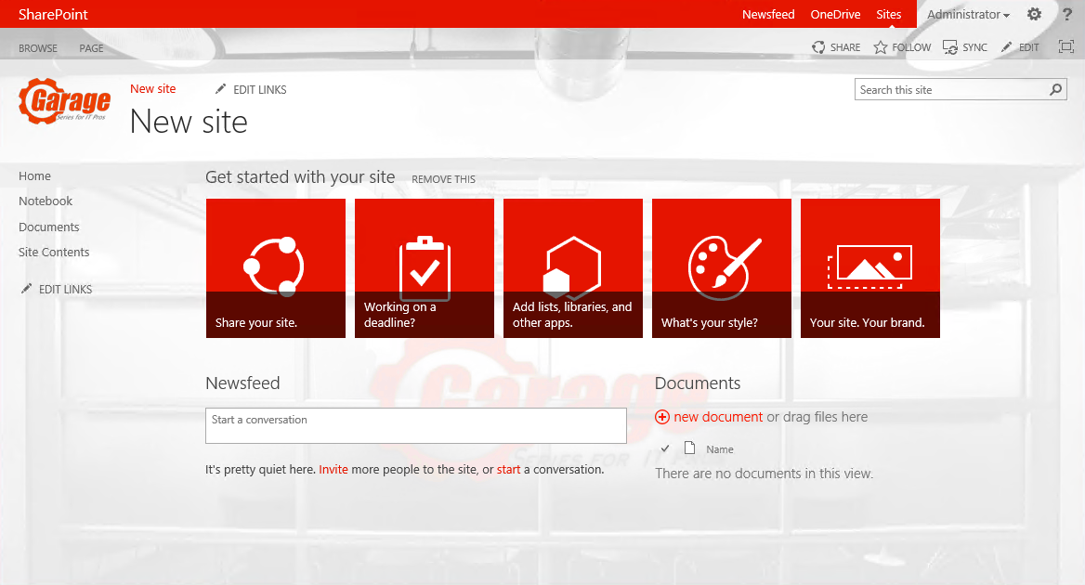
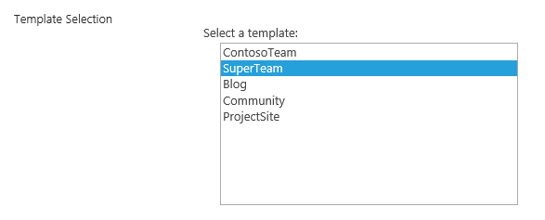
Demo - Hybrid provisioning from Azure
Company
SharePoint Farm
2
5
6
1
Storage Queue
Service Bus Relay
https://teams.contoso.com /sites/site
Provider Hosted Apps
WebJob
SharePoint Service
3
4
Based on the end user selection, actual creation of the site collection will be done either to on-premises or to the cloud.
https://contoso.sharepoint.com /sites/site

Slide 27
Azure based provisioning engine – hybrid scenario
Demo
https://github.com/OfficeDev/PnP/tree/master/Samples/Provisioning.Hybrid.Simple
Notes:
Vesa

Slide 28

Recommendations
App model recommendations
Full trust code recommendations
General notes

Slide 29
Sandbox solutions?
Code behind sandbox solutions are deprecated
Shows the direction where we are heading
No centralized control for sandbox solutions
No enterprise level capabilities for controlling available solutions
Possible orphan issues with deactivation
Still based on feature framework with it’s caveats
“We deployed custom default.aspx and now things are broken”
Requires deep understanding of SharePoint’isms
Update operations will require code anyway
Notes:
Steve
Time: 13:00

Slide 30
“Wait? No feature framework?”
We are indeed gradually moving away from feature framework to alternative patterns…
Notes:
Steve
Time: 15:00

Slide 31
“You do not brand Outlook or Word, why do you need to do branding on collaboration sites?”
Good question…
Applying branding is absolutely supported and understandable for intranet portals, but what about collaboration sites? It is recommended to consider the cost versus gain

Slide 32
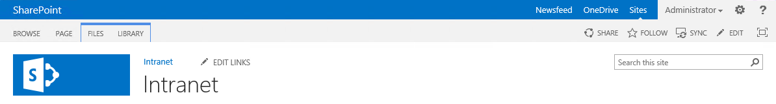
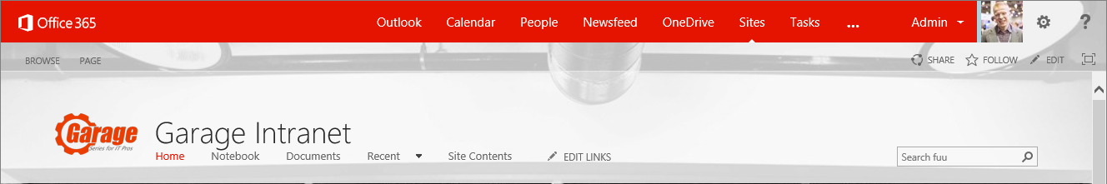
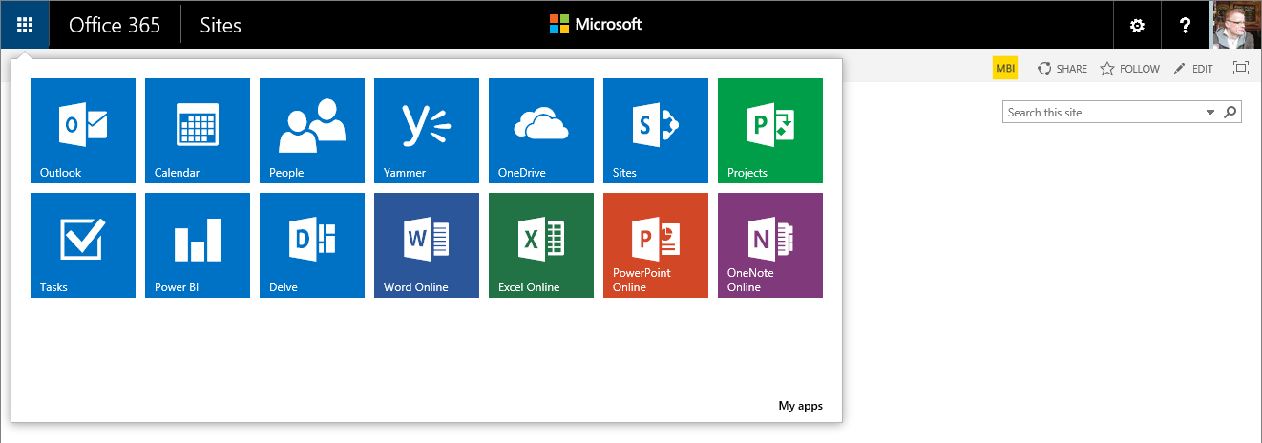
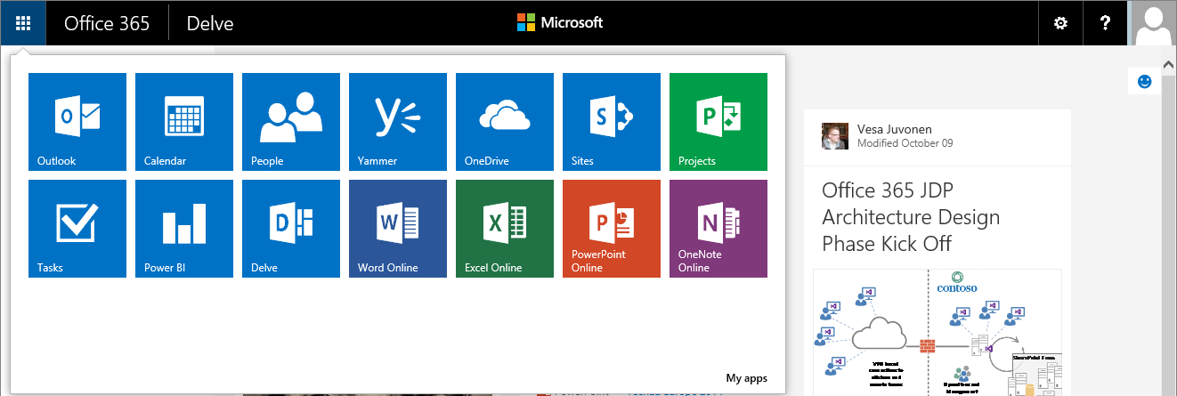
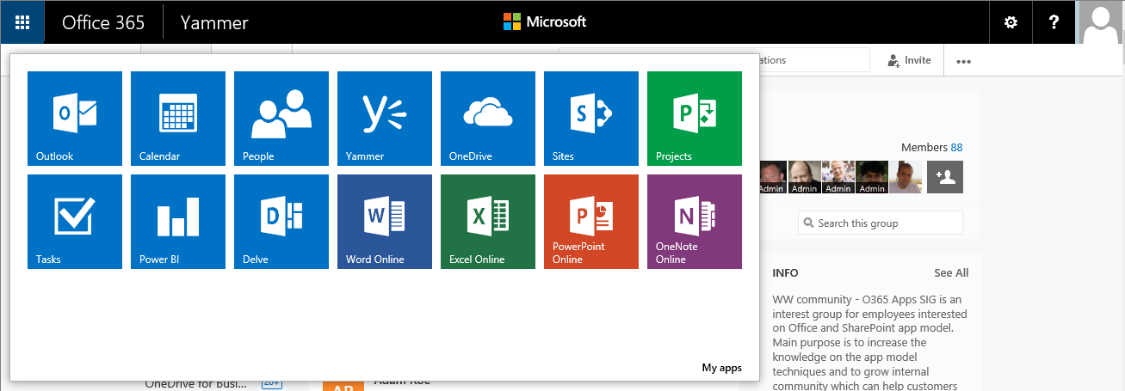
Example: Custom master page and case of an evolving suite bar…
Notes:
Vesa Great Slide to explain the methodology and thinking behind why we want to discourage these EXC

Slide 33
“But I have always customized my sites with custom master, what has changed?”
Nothing
Actually this similar maintenance challenge exists in on-premises and across the version upgrades as well. Concentrate on what’s truly needed.
Notes:
Vesa

Slide 34
“I have an intranet portal and I need to do heavy branding customizations!”
Absolutely fine.
Key point is to understand the impact of the chosen pattern. Custom master pages are completely supported, you might want to use alternative approaches if possible.
Notes:
Vesa

Slide 35
Branding with app model
Demo
https://github.com/OfficeDev/PnP/tree/master/Samples/Branding.AlternateCSSAndSiteLogo
Notes:
Vesa

Slide 36
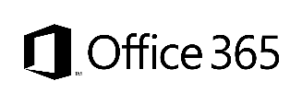

Branding options for SharePoint sites
Custom Master Page
Alternate CSS
Theme
Office 365 Themes
Full control on how the site is rendered
Applied to each site, except for publishing sites
Any updates to oob master pages are not automatically reflected on the sites
Can be used to override whatever CSS settings
Control to color, fonts and even layout settings
Configuration applied to each site
Can be used to control branding, fonts and background image of the sites
Configuration applied to each site
Can be used to centrally control branding cross all services in the Office 365
Limited settings currently
Can be overridden in site level
Only in Office 365, not in on-premises
Options
Support
only
Flexibility
Unlimited
Good
Average
Fair
Cost impact (short and long term)
Notes:
Vesa & Steve Dialog

Slide 37
Recommendations for farm solutions How to minimize future work?
Use code from feature receivers, not declarative approaches where possible
Create especially content types and site columns using code
Custom fields types
Custom site definitions
Custom list definition

Slide 38
“I’m moving to cloud, couldn’t I transform as part of the move?”
Yes…
You could combine these two steps to one big bang approach, but solving possible issues could be more difficult. Doing app model move as separate step is less risky.

Slide 39
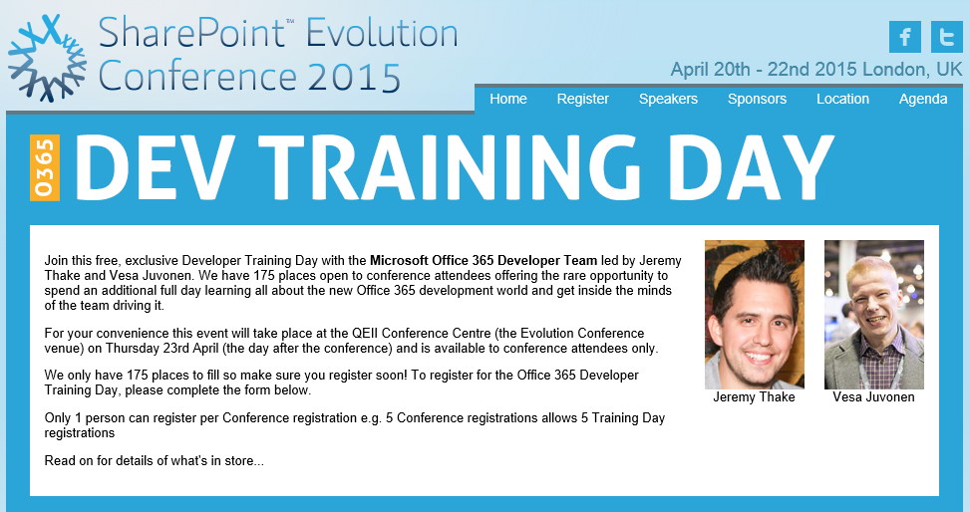
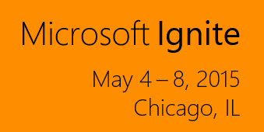
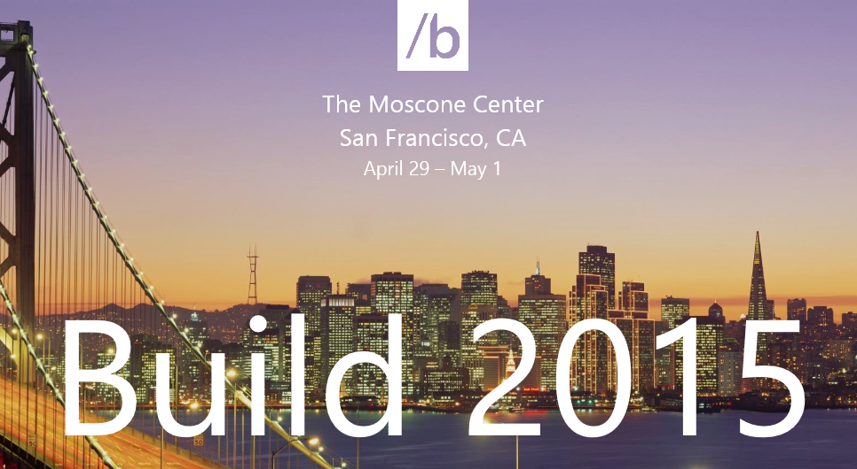
Transformation topics in spring seminars

Slide 40

Questions?

Slide 41


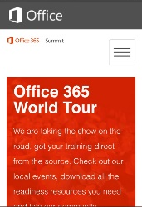
dev.office.com
Sign up
http://dev.office.com/getting-started
Explore
http://apisandbox.msdn.microsoft.com
Get trained http://dev.office.com/training

Slide 42


Feedback
Office 365 Network Share you best practices and join conversations
https://www.yammer.com/itpronetwork
Stackoverflow Ask deep technical questions to a world-wide set of developers
http://stackoverflow.com/questions/tagged/ms-office
UserVoice Provide suggestions of what you want in future versions
http://officespdev.uservoice.com/

Slide 43


© 2015 Microsoft Corporation. All rights reserved. Microsoft, Windows, and other product names are or may be registered trademarks and/or trademarks in the U.S. and/or other countries.
The information herein is for informational purposes only and represents the current view of Microsoft Corporation as of the date of this presentation. Because Microsoft must respond to changing market conditions, it should not be interpreted to be a commitment on the part of Microsoft, and Microsoft cannot guarantee the accuracy of any information provided after the date of this presentation. MICROSOFT MAKES NO WARRANTIES, EXPRESS, IMPLIED OR STATUTORY, AS TO THE INFORMATION IN THIS PRESENTATION.

